Slide 1


Blue Carbon Chain: A Transparent and Equitable Registry
Problem Statement ID: 25038
Problem Statement Title: Blockchain-Based Blue Carbon Registry and MRV System
Theme: Clean & Green Technology
Category: Software
Team ID: O2
Team Name: Group Phi
Notes:
‹#›

Slide 2

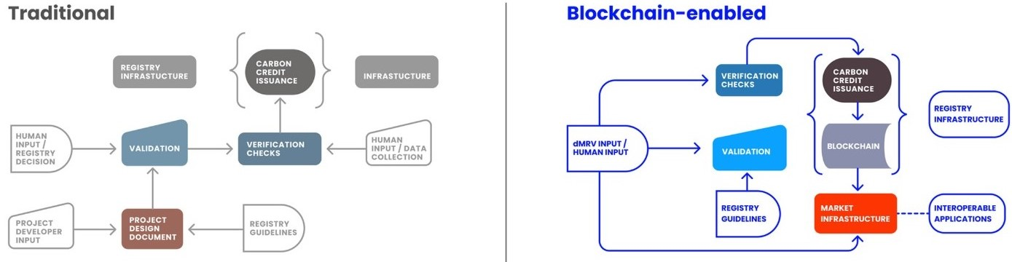
Our Proposal: A Blockchain-Powered Solution
Traditional vs. Blue CarbonChain Approach
Traditional Carbon Market Registry
Blue CarbonChain's Blockchain Approach
Often relies on centralized databases, manual verification processes, and limited public accessibility. This can lead to:
Leverages blockchain technology to establish an immutable, transparent, and efficient system for carbon credit management:
Opacity and lack of visibility into data.
Transparency: All transactions and verified data are publicly auditable on the blockchain.
Potential for double-counting or fraudulent credits.
Slow, inefficient verification cycles.
Immutability: Data cannot be altered once recorded, preventing fraud and greenwashing.
Difficulty in ensuring equitable distribution of benefits.
Efficiency: Smart contracts automate issuance and retirement, speeding up processes.
Traceability: Credits are linked directly to real-world blue carbon projects with verifiable MRV data.
2
Notes:
‹#›

Slide 3


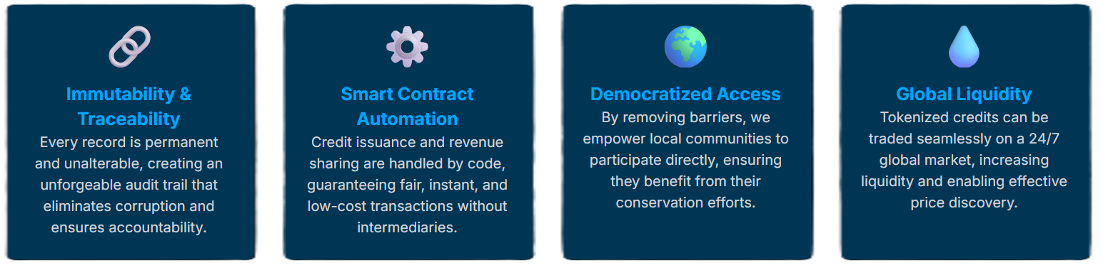
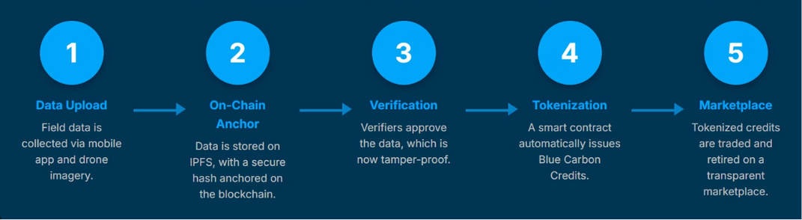
Technical Approach: How We'll Build It
Why Blockchain?
In a country where systemic challenges can undermine trust, blockchain isn't just an upgrade—it's a paradigm shift. Its inherent features provide the robust foundation needed for a fair, efficient, and globally recognized carbon market that delivers on its promises.
Key Technologies
Data Flow & Methodology
Blockchain: Polygon Testnet for low costs and speed, Solidity for smart contracts, OpenZeppelin for security.
Our process ensures data integrity from collection to credit issuance:
Storage: IPFS / Web3.Storage for decentralised, secure storage of large field data files (photos, drone videos).
Frontend: React / React Native for a user-friendly, cross-platform mobile and web interface.
Backend: Node.js / Express for robust API development.
Open-Source Advantage:
The feasibility of this project is greatly enhanced by the availability of mature, open-source technologies. This provides a wealth of resources and a supportive developer community, making our build highly achievable.
Notes:
‹#›

Slide 4

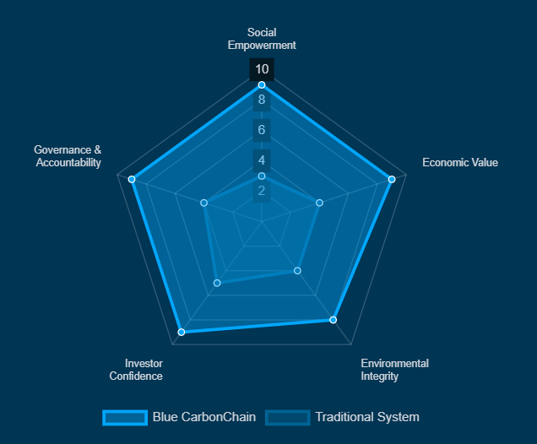


Impact and Benefits: A Triple Win
Government
Companies/Polluters
Provides a reliable and transparent national registry, helping India meet its climate commitments and enhancing its global standing in environmental stewardship.
Offers a credible and verifiable way to offset emissions, promoting genuine corporate responsibility and fostering a sustainable business ecosystem.
Our solution delivers comprehensive benefits:
Social: Empowers local communities with direct participation and economic benefit, fostering environmental stewardship and reducing inequality.
Economic: Monetises restoration efforts through transparent carbon credits, attracting investment and creating new green economic opportunities. Creates a new, fair, and direct revenue stream from their conservation efforts, empowering them as climate stewards and improving livelihoods.
Environmental: Accelerates coastal ecosystem restoration, protects vital biodiversity, and strengthens climate resilience against extreme weather events.
Notes:
‹#›

Slide 5

Feasibility and Viability: Making it Real
Analysis of Feasibility
Potential Challenges & Strategies
Technical: Our solution leverages existing, proven blockchain frameworks. We are not inventing new technology but applying mature solutions to a critical problem.
Challenge
Strategy to Overcome
Data Accuracy
Implement robust verification protocols by NCCR admin tools and real-time field data integration.
Operational: We will overcome user training challenges for NGOs and communities by developing a simple, intuitive, offline-first mobile app with clear, guided workflows, ensuring widespread adoption.
Regulatory Alignment
Pilot projects and a modular design to adapt to evolving carbon market standards.
Why we'll able to do it: We possess a fundamental understanding of the core technologies, have a well-defined strategic plan, and benefit from blockchain's open-source nature, providing extensive learning resources and a robust foundation for development.
User Adoption
Community engagement, co-creation with NGOs, and intuitive app design.
Notes:
‹#›

Slide 6

References and Research
Our work is informed by leading research and insights into blockchain, carbon markets, and environmental verification:
Frontiers in Blockchain: "Blockchain-based voluntary carbon market: strategic insights..." https://www.frontiersin.org/journals/blockchain/articles/10.3389/fbloc.2025.1603695/full
CarbonMark: "The Rise of Tokenized Carbon Credits: Why Blockchain is Changing Everything" https://www.carbonmark.com/post/the-rise-of-tokenized-carbon-credits-why-blockchain-is-changing-everything
Prism.Sustainability-Directory.com: "Blockchain for Transparent Blue Carbon Credit Markets" https://prism.sustainability-directory.com/scenario/blockchain-for-transparent-blue-carbon-credit-markets/
World Bank: "What You Need to Know About the Measurement, Reporting and Verification (MRV) of Carbon Credits" https://www.worldbank.org/en/news/feature/2022/07/27/what-you-need-to-know-about-the-measurement-reporting-and-verification-mrv-of-carbon-credits
Thank you for your time and consideration.
Notes:
‹#›

